Slide 1
Coordinated Entry (CE) Refinement Lab
Meeting 1: What in the world is coordinated entry and a refinement lab?
Notes:
Roanoke- Matt
Welcome to our first meeting

Slide 2
Introductions
-Your Name, Preferred Pronouns, Organization, Years working to end homelessness
-Pick one and answer:
What do you think Coordinated Entry is designed to do?
Do you have any concerns about Coordinated Entry?
What scares you most about Coordinated Entry?
Notes:
Roanoke- Matt
Quick Introductions

Slide 3
Coordinated Entry System
is a process designed to quickly identify, assess, refer and connect people in crisis to housing and assistance, no matter where they show up to ask for help
Notes:
Joan
What is a Coordinated Entry System
Coordinated entry is an important process through which people experiencing or at risk of experiencing homelessness can access the crisis response system in a streamlined way, and quickly connect to appropriate, tailored housing and mainstream services within the community Standardized assessment tools and practices used within local coordinated assessment processes take into account the unique needs of children and their families as well as youth. When possible, the assessment provides the ability for households to gain access to the best options to address their needs, incorporating participants’ choice, rather than being evaluated for a single program within the system. The most intensive interventions are prioritized for those with the highest needs. Opening Doors, p. 57
Definition of “Coordinated Entry” Over the last few years, the coordinated entry process has been described variously using some combination of the words centralized or coordinated; intake, assessment, or entry; and process or system. Some of these names have emphasized just one aspect—such as intake or assessment—or have seemed to imply that coordinated entry can only be conducted in one central place. In HUD’s vision, the coordinated entry process is an approach to coordination and management of a crisis response system’s resources that allows users to make consistent decisions from available information to efficiently and effectively connect people to interventions that will rapidly end their homelessness. In the Notice Establishing Additional Requirements for a Continuum of Care Centralized or Coordinated Assessment System, HUD indicated that although the regulatory term is “centralized and coordinated assessment system,” for policy reasons HUD and other federal partners refer to it as the “coordinated entry process”—and to the document itself as the “Coordinated Entry Notice.” This change emphasizes that the process is not just about assessment but also about facilitating entry into the crisis response system and exit into housing. This Guidebook uses the term “coordinated entry” throughout.

Slide 4
Coordinated Entry Goals
People experiencing homelessness:​
who need assistance the most (THE MOST VULNERABLE with MOST severe service needs) are prioritized for housing
can easily access assistance no matter where or how they present
Notes:
Joan
What is a Coordinated Entry System

Slide 5
Who is part of the CE
It is a community process
ALL COC agencies are partners whether funded or not
CoC and ESG funded agencies are required to participate in CE
Notes:
Joan
CE is not just the CE lead it is all coc agencies

Slide 6
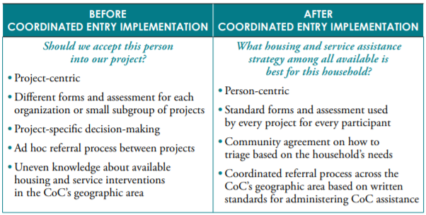
Notes:
Stop for reactions anything that you did not know that stood out?

Slide 7
Coordinated Entry Lab
is an agile process to identify CE challenges and strategies to refine existing CE system to better services for the most vulnerable persons
Notes:
Joan
So what is this CE lab we keep talking about
Overview of refinement lab
Time Commitment
Expectations
Goal Statement

Slide 8
Lab Process / components
A diverse/ inclusive workgroup (that's you everyone in this meeting)
Identified areas of improvement / areas not in compliance
Develop and Prioritize Strategies
Create action plan for the strategies
Monitoring / evaluation of effectiveness of strategies
Notes:
Joan

Slide 9
Lab Time commitment: Estimate 20 hrs
Meeting 1: Intro to Lab & CE Overview
Meeting 2: Understand Existing System
Meeting 3: Access Barriers & Improvement Strategies
Meeting 4: Assessment Barriers & Improvement Strategies
Meeting 5: Prioritization Barriers & Improvement Strategies
Meeting 6: Referral and Housing Placement Barriers & Improvement Strategies
Meeting 7: Mapping the Ideal System
Meeting 8: Action Plan Development
Meeting 9: Wrap Up- Finalize Action Plan & Agree on evaluation monitoring procedures
*Lab Ends – Define Ongoing CE meetings & Next steps

Slide 10
Sub working groups
Workflow development in HMIS
Training Implementation
P&Ps
Prioritization - By Name List development

Slide 11
But first the basics
Understand the core elements of CE and the basic requirement
Understand how it is happening in your community
Notes:
In order to refine the existing system we need to be able to understand the core elements of CE and the basic requirement
And understand how it is happening in your community
Can anyone tell me what the core elements of CE are ?

Slide 12
Core Elements Guide
Notes:
Core components for CE
Will be talking about these core components and some of the HUD established requirements
Who do these requirements apply to – Ideally you want every provider working on homelessness to adop hoewer this IS a requirement fro all CoC and ESG funded agencies.

Slide 13
Notes:
Core components for CE
Access- Engagement point – how and where people access they crisis response system ( full coverage, outreach, emergency services, . diversion)

Slide 14
Access Requirements
same assessment approach & standardized decision-making, at all access points
all access points are usable by all homeless persons
participants may not be denied access to CE because they have been a victim of domestic violence
access point(s) must be easily accessed
access to emergency services during afterhours and weekends
Street outreach are linked to CE (ESG/ CoC Funded)
Notes:
Define access and go over requirements
Who do these apply to ?
Accessibility ,Emergency Services, Prevention Services , Full Coverage , Marketing , SO

Slide 15
Notes:
Core components for CE
Assessment for housing needs, preferences and vulnerabilities- Progressive ( one common assessment tool only the designated 5 subpopulations can have difference criteria for scoring)

Slide 16
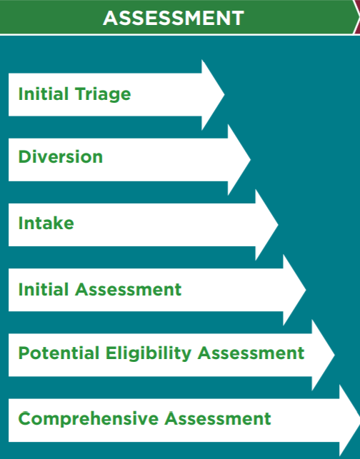
Assessment Requirements
Does not screen out people out of the coordinated entry process due to perceived barriers to
including, but not limited to
too little or no income
substance abuse
domestic violence history
resistance to receiving service
the type or extent of a disability
related services or supports that are needed
history of evictions or poor credit, lease violations or history of not being a leaseholder
criminal record
Notes:
Define assessment and go over requirements
The assessment is used to find housing for persons NOT SCREEN OUT

Slide 17
Notes:
Core components for CE
Prioritization – helps manage inventory and community resources and services to ensure those with highest needs and vulnerability get the support they need. Prioritization Notice

Slide 18
Those with the longest time homeless
&
who have the most severe service needs within a community
are prioritized for PSH
Notes:
Notice on Prioritizing Persons Experiencing Chronic Homelessness and Other Vulnerable Homeless Persons in Permanent Supportive Housing
https://www.hud.gov/sites/documents/16-11CPDN.PDF
*each community has their prioritization policy

Slide 19
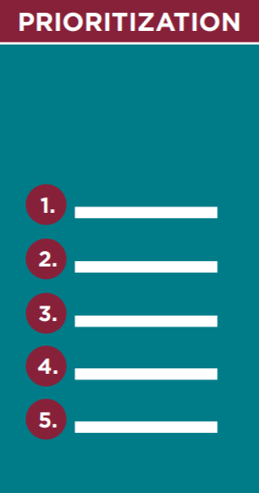
Prioritization Requirements
CoC uses the CE process to prioritize homeless persons
Prioritization is based on a specific and definable set of criteria that are documented, made publicly available and applied consistently throughout the CoC for all populations
CoC’s written policies and procedures include the factors and assessment information with which prioritization decisions are made.
CoC’s prioritization policies and procedures are consistent with CoC and ESG written standards under 24 CFR 578(a)(9) and 24 CFR 576.4.
Notes:
*Note – Refer to HUD Prioritization Notice: CPD-16-11 for detailed guidance on prioritizing persons experiencing chronic homelessness and other vulnerable homeless populations in permanent supportive housing

Slide 20
Prioritization Recommended
CoC uses any combination of the following factors to prioritize homeless persons:
• Significant challenges or functional impairments, including physical, mental, developmental, or behavioral health challenges, which require a significant level of support in order to maintain permanent housing.
• High utilization of crisis or emergency services to meet basic needs.
• Extent to which persons, especially youth and children, are unsheltered.
• Vulnerability to illness or death.
• Risk of continued homelessness.
• Vulnerability to victimization, including physical assault, trafficking, or sex work
Notes:
*Note – Refer to HUD Prioritization Notice: CPD-16-11 for detailed guidance on prioritizing persons experiencing chronic homelessness and other vulnerable homeless populations in permanent supportive housing

Slide 21
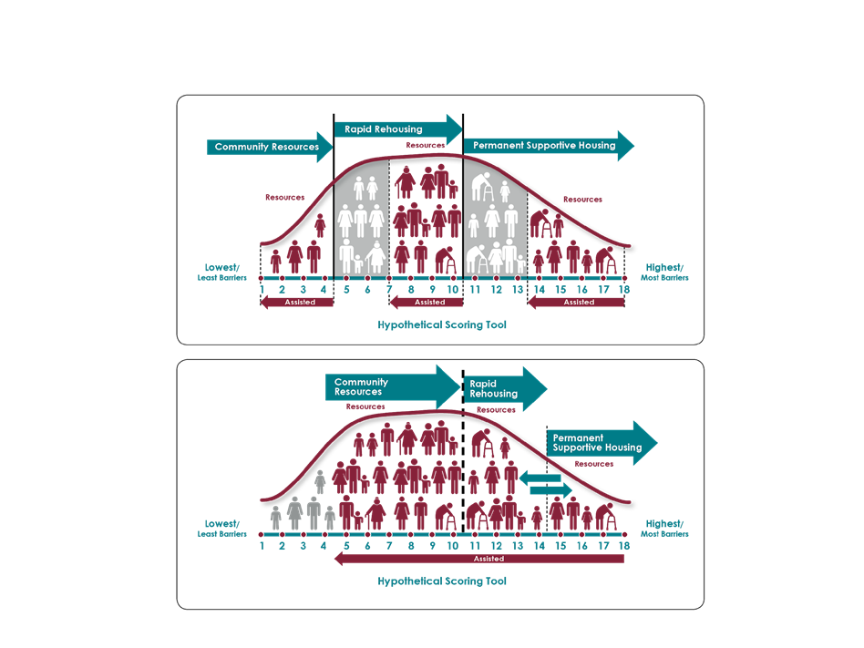
Notes:
Explain visual and then ask
What do you see as the problem?

Slide 23
Referral Requirements
CoC’s CE process includes uniform and coordinated referral process for all beds, units, and services HUD Coordinated Entry Notice: Section II.B.3
CoC and projects participating in the coordinated entry process do not screen out based on perceived barriers related to housing or services.
CoC- and ESG-program recipients and subrecipients use the coordinated entry process as the only referral source from which to consider filling vacancies in housing and/or services funded by CoC and ESG programs.

Slide 24
Basic Components of CES
Access
Assessment
Assignment
Accountability
Front Doors
Diversion Screen
Real-Time Unit Availability
Performance Dashboard
Coordinated Outreach
Prioritization Policy
Qualitative Evaluation
Phased Assessment
Call Center
Referral Process
Policy and Procedure Manual
Common Assessment Tools
Prevention
Case Conferencing
Lead Entity
© All rights reserved. No utilization or reproduction of this material is allowed without the written permission of CSH

Slide 25
CE Data & Accountability
Required annual CE evaluation
Effectiveness is ensuring not only that the CE is operating as intended, but also that the CE is positively affecting the overall system performance. This evaluation creates an opportunity to modify CE operations to better achieve positive outcomes.
HUD’s New Coordinated Entry Data Elements
https://files.hudexchange.info/resources/documents/HUDs-New-Coordinated-Entry-Data-Elements.pdf
Notes:
Coordinated Entry Management and Data Guide
Though HUD does not prescribe the scope or specific methods of the required annual CE evaluation, the effectiveness and efficiency of the CE process, feedback about the ease of use from persons experiencing a housing crisis, and an assessment of referral outcomes should all inform the annual update to the CoC’s policies and procedures and regular updates to ESG written standards. Effectiveness is ensuring not only that the CE is operating as intended, but also that the CE is positively affecting the overall system performance. This evaluation creates an opportunity to modify CE operations to better achieve positive outcomes.

Slide 26
What are some questions that your data collection should help answer?
Are pathways to housing as fast and effective as they can be?
Are we successfully diverting people from the system?
Are we housing the most vulnerable people in our community
Who’s getting left out?
What resources are needed to end homelessness and where are the gaps?
Which households touch the system and exit without a homelessness intervention versus those who need our assistance?
Notes:
what are some questions that your data collection should help answer?
Coordinated Entry Management and Data Guide
https://files.hudexchange.info/resources/documents/coordinated-entry-management-and-data-guide.pdf
4.1 Establishing a CE Evaluation Plan The plan for conducting this evaluation should be developed early in the process of planning coordinated entry and then reviewed frequently throughout its implementation. Setting up the plan for collecting the data necessary to carry out a full and complete evaluation takes time and considerable forethought; data that are not collected cannot be analyzed. CoCs must ensure that evaluation is on their implementation planning agenda from day one, even if the planned evaluation is relatively small in scope. In establishing an evaluation plan, the evaluation responsibilities should include the following: ● Determine which aspects of the effectiveness of its system will be measured. ● Determine which aspects of the process will be evaluated for fidelity to CE policies and procedures and HUD’s coordinated entry requirements. ● Determine how to gather data to track the selected measures, incorporating in the evaluation process the required stakeholders, at a minimum. ● Determine whether and how the CoC uses evaluation results to inform other aspects of system planning and monitoring, including evaluating whether the CoC has too much or too little of certain housing and supportive services resources overall and for specific subpopulations (e.g., youth, adults with children). ● Coordinate with partners (e.g., ESG recipients, SSVF recipients, etc.) so data are collected consistently across programs, to make sure evaluations are thorough and coordinated. The CoC also may consider

Slide 27
Questions Clarifications

Slide 28
The Ideal Workgroup Composition
Diversity across
race, ethnicity, gender, and sexual orientation
departments, agencies, or other key units of government
provider types (shelter, RRH, PSH) and populations
work levels, functions and authority, including supervisors, frontline staff directly delivering services, and data/evaluation staff
Representatives with lived experience
Notes:
Matt

Slide 29
The team
Agency | Name | System Role
ARCH | Kevin Liptrap | Emergency Shelter Leadership
 | Willie Foster | Emergency Shelter Leadership
 | Phil Anderson | CoC PSH Leadership
Blue Ridge Behavioral Healthcare (BRBH) | Brittany Huffer | PATH Leadership
 | Hannah Evans | PATH Staff
 | Susan Price | DBHDS PSH Leadership
 | Paula Prince | CoC Board Chair
City of Roanoke | Matt Crookshank | CoC Leadership, CoC street outreach & CES leadership
 | Sandy Peggins | CES Staff
 | Hope Browning | ESG Grantee
Council of Community Services | Alison Jorgensen | CoC Planning
 | Brian Burnette | RRH, Homelessness Prevention, HMIS Leadership
 | Ben Bristoll | HMIS System Administrator
 | Reagan Costello-White | HMIS Staff
 | Amanda Holcomb | 2-1-1 Community Engagement
Family Promise of Greater Roanoke | Marie Muddiman | Emergency Shelter Leadership
 | Tina Moore | Emergency Shelter Staff
Presbyterian Community Center | Ebony Hurt | Financial Assistance Leadership
Roanoke Area Ministries (RAM) | Melissa Woodson | Day Shelter & Financial Assistance Leadership
 | Linda Cannon | Day Shelter Staff
 | Joann Wormley | Financial Assistance Staff
Roanoke Rescue Mission | Helen Ferguson | Emergency Shelter Leadership
SafeHome Systems | Pat Trees | Domestic Violence Shelter Leadership
Salem VA Medical Center Salem VA Medical Center | Tanyia Jones | VA Homeless Services Coordinator
 | Jeff Doyle | HUD-VASH Coordinator
Salvation Army | Captain Jamie Clay | Domestic Violence Shelter Leadership
 | Jaimie Goodman | Financial Assistance/Supportive Services Leadership
Total Action for Progress (TAP) | Jo Nelson | SSVF, Homelessness Prevention Leadership
 | Hannah Jarrett | Homelessness Prevention Leadership
 | Stacey Sheppard | Domestic Violence Services Leadership
 | Chelita Burwell | Domestic Violence Services Staff
 | Evelyn Jordan | SSVF Staff
Notes:
Alison
Is there representation missing?
Who is missing at the table?

Slide 30
What’s Next?
Determine meeting frequency
Next meeting – Review Understand Current CE System (CE Checklist & workflow)
Notes:
Matt
https://www.hudexchange.info/resource/5219/coordinated-entry-self-assessment/

Slide 31
CE Resources
● HUD Coordinated Entry Notice CPD-17-01 – Notice Establishing Additional Requirements for a Continuum of Care Centralized or Coordinated Assessment System (2017)
● HUD Prioritization Notice CPD-16-11 – Notice on Prioritizing Persons Experiencing Chronic Homelessness and Other Vulnerable Homeless Persons in Permanent Supportive Housing (2016)
● Coordinated Entry Policy Brief (2015)
● CoC Program interim rule: 24 CFR 578.7(a)(8)
● ESG interim rule: 24 CFR 576.400(d)
● HUD Equal Access rule: 24 CFR 5.105(a)(2) and 5.106(b)

Slide 32
Qualities of Effective Coordinated Entry Systems
Prioritization
Low Barrier
Housing First Orientation
Person-Centered
Fair and Equal Access
Standardized Assessment by Trained Assessors
Standardized Referral Protocols
Direct Referral to Projects
Notes:
COORDINATED ENTRY POLICY BRIEF
Here are some of the qualities that make up an effective Coordinated Entry system (continued on next slide)
Prioritization. HUD has determined that an effective coordinated entry process ensures that people with the greatest needs receive priority for any type of housing and homeless assistance available in the CoC, including PSH, Rapid Rehousing (RRH), and other interventions
Low Barrier. The coordinated entry process does not screen people out for assistance because of perceived barriers to housing or services, including, but not limited to, lack of employment or income, drug or alcohol use, or having a criminal record. In addition, housing and homelessness programs lower their screening barriers in partnership with the coordinated entry process.
Housing First orientation. The coordinated entry process is Housing First oriented, such that people are housed quickly without preconditions or service participation requirements.
Person-Centered. The coordinated entry process incorporates participant choice, which may be facilitated by questions in the assessment tool or through other methods. Choice can include location and type of housing, level of services, and other options about which households can participate in decisions.
Fair and Equal Access. All people in the CoC’s geographic area have fair and equal access to the coordinated entry process, regardless of where or how they present for services. Fair and equal access means that people can easily access the coordinated entry process, whether in person, by phone, or some other method, and that the process for accessing help is well known. Marketing strategies may include direct outreach to people on the street and other service sites, informational flyers left at service sites and public locations, announcements during CoC or other coalition meetings, and educating mainstream service providers. If the entry point includes one or more physical locations, they are accessible to people with disabilities, and easily accessible by public transportation, or there is another method, e.g., toll-free or 211 phone number, by which people can easily access them. The coordinated entry process is able to serve people who speak languages commonly spoken in the community.

Slide 33
Why does Coordinated Entry Matter?
Clear points of access for homeless individuals
Standardized assessment
Standardized/
coordinated referral process
Real-time knowledge of housing availability
Strategically targeting resources efficiently and accurately in order to maximize the use of scarce resources
The most vulnerable don’t fall between the cracks
More accountability and accurate matching = more confidence in investing in development
Ability to track collective impact
Notes:
Why does CE matter

