Slide 1
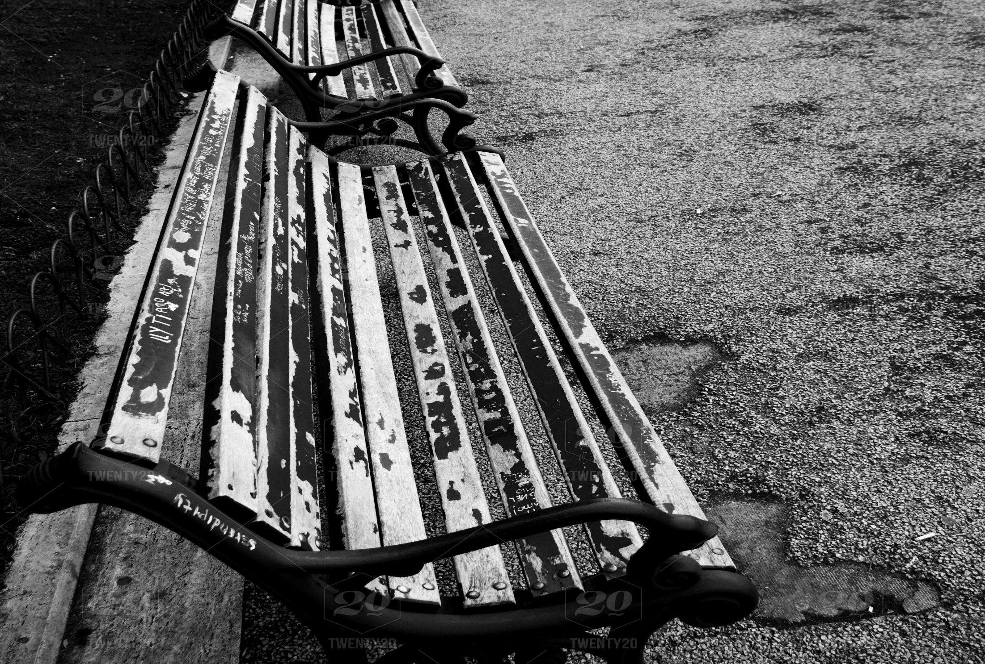
2018 Annual Point-in-Time Report
March 2018

Slide 2
About this Report
Point-in-Time (PIT) counts of sheltered and unsheltered people experiencing homelessness occur yearly in each jurisdiction in Virginia.
The Blue Ridge Interagency Council on Homelessness, the governing body for homeless services in the region, is the lead entity that conducts the PIT count annually.
To ensure that all are counted, homeless service providers from the City of Roanoke’s Homeless Assistance Team, the Salem VA Medical Center, Blue Ridge Behavioral Healthcare and volunteers from the Jefferson College of Health Sciences searched the streets, under bridges, in doorways and other places to identify, count and interview the unsheltered on the night of January 24, 2018.
The data collected provides valuable information to area service providers, policy makers, and the general public on the individual and family challenges and barriers associated with homelessness.
In addition to numbers counted, this report includes demographic characteristics for all people experiencing homelessness, people experiencing homelessness in households without children, people in families with children, and veterans experiencing homelessness.
For the first time, this 2018 report uses hard count and survey data obtained directly from the Homeless Management Information System (HMIS) for all emergency shelter providers (excluding DV).

Slide 3
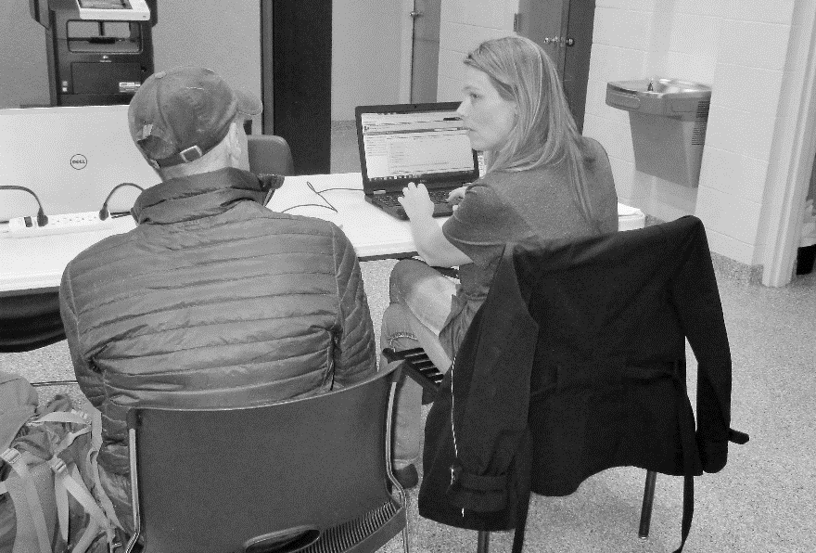
Methodology
This 2018 Point-in-Time Count and Homeless Survey Report presents a snapshot of data obtained on the night of January 24th from sheltered and unsheltered people in the Blue Ridge Continuum of Care (CoC) Region of Virginia: Alleghany County, Botetourt County, Craig County, Roanoke County and the cities of Covington, Roanoke and Salem.
The instruments used to collect survey data were the Vulnerability Index – Service Prioritization Decision Assistance Tool (VI-SPDAT) v2.0 for single adults, the VI-SPDAT v2.0 for families, and 16 supplemental questions.
The VI-SPDAT v2.0, the CoC's primary common assessment tool, is administered to all homeless individuals and/or families upon entry into the region’s coordinated system of care to determine 1) the level of vulnerability for the individual or family; and 2) to prioritize services based on vulnerability.
VI-SPDAT data are entered into the Homeless Management Information System (HMIS) in addition to other essential elements such as demographic characteristics; homelessness and housing histories; and income and benefit amounts.

Slide 4
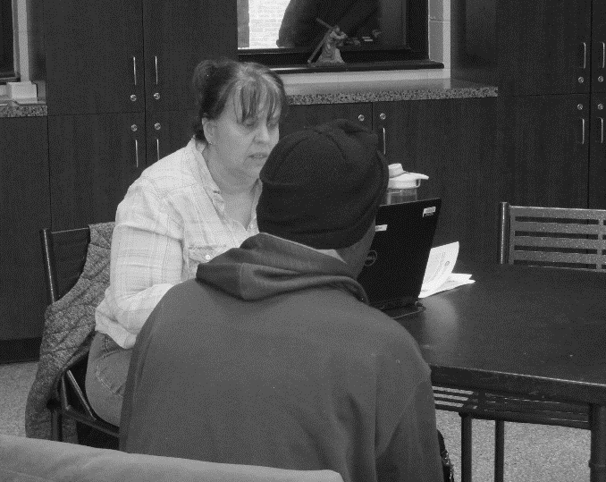
PIT Count Key Findings
317 people were experiencing homelessness in the Blue Ridge CoC.
A majority, 96.5%, (306) were staying in emergency shelters, and 3.5% (11) were in unsheltered locations.
Of those experiencing homelessness, 18.3% (58) were children, 74.4% (236) were over the age of 24, and 5.7% (18) were between the ages of 18 and 24.
Between 2017 and 2018, the number of people experiencing homelessness in the Blue Ridge CoC increased by 18.7%. (267 in 2017 and 317 in 2018).
Homelessness decreased among people staying in unsheltered locations by 35.3%. (17 in 2017 and 11 in 2018).
A trend of decreasing numbers over the past six years in the Blue Ridge CoC shows our high water mark count in 2012 was 561. The count has decreased by 43.5% since 2012.

Slide 5
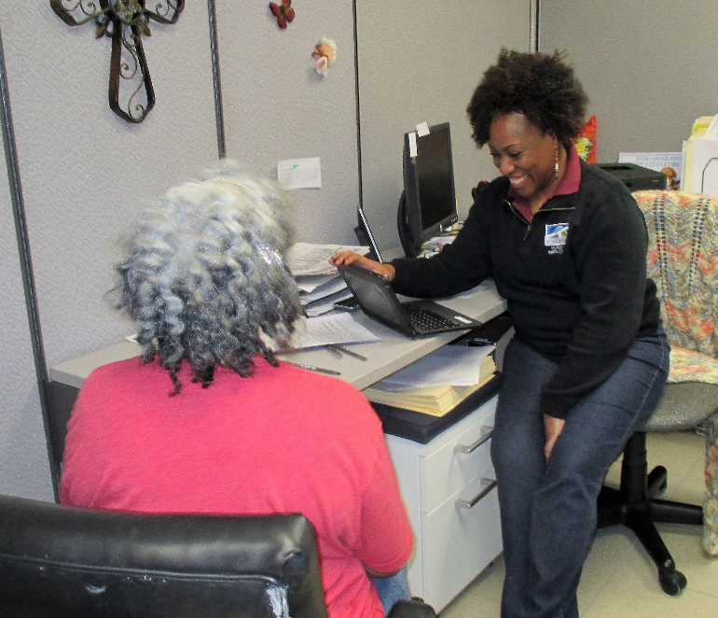
Homelessness by Subpopulation
37 veterans were experiencing homelessness, representing an increase of 15.6% over 2017 (32).
All veterans were homeless in households without children (as individuals) and all were staying in shelters; 4 chronically homeless veterans were counted
There were 27 individuals in households without children and eight people in families with children with chronic patterns of homelessness.
Chronic homelessness declined by 25.0% between 2017 (48) and 2018 (36), and by 75.8% between 2012 (149) and 2018.
There were 11 unaccompanied homeless youth between the ages of 18 and 24 counted in 2018 (one unsheltered).
There were 11 individuals in four parenting youth households (four youth), all were sheltered.

Slide 6
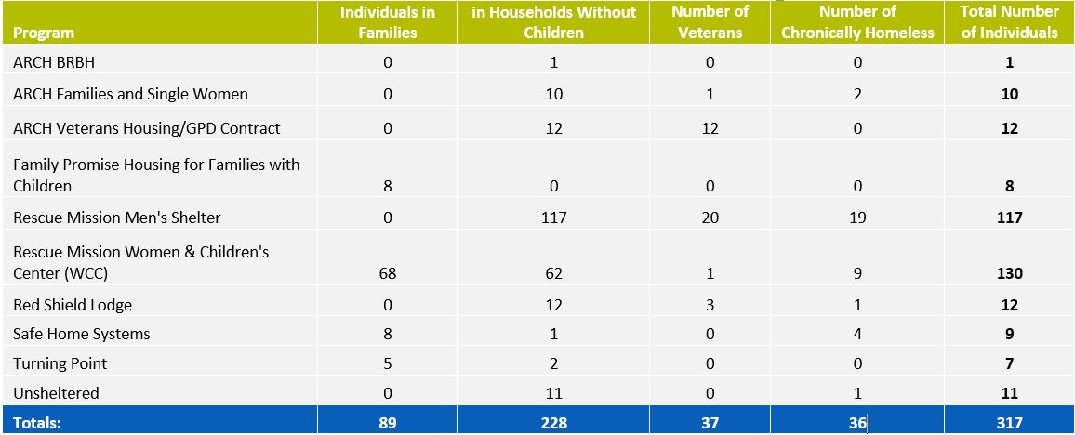
Where individuals were staying

Slide 7
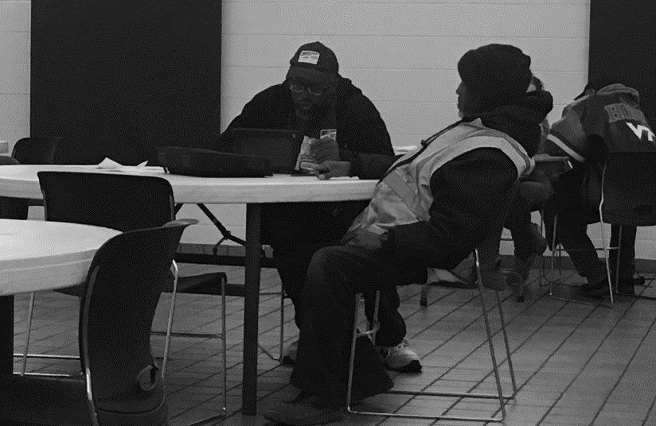
Restructuring for Results
In 2012, the Blue Ridge Continuum of Care began a transformation of its service system that included changes in strategies to reduce homelessness.
Based on national research, the new strategies focused on providing targeted homelessness prevention services and rapidly re-housing those who experience homelessness then providing the support services needed to maintain housing stability in the long-term.
The Housing First model is one component of an ongoing effort by the Blue Ridge Interagency Advisory Council and the Continuum of Care to improve services and efficiencies.
The model operates under the assumption that housing is a basic right and that individuals should not have to meet any pre-conditions to qualify for or earn housing.
Between 2012 and 2018, the number of people experiencing homelessness has been reduced by 43.5% from 561 to 317, as a result of the willingness of homeless service providers to restructure the way services are provided.

Slide 8
Opening Doors: The Federal Strategic Plan to Prevent and End Homelessness
The Blue Ridge Continuum of Care’s alignment with and progress against goals and priorities set forth in the Federal plan to end homelessness: 2012-2018

Slide 9
Strategic Goals and Results Achieved 2012 - 2018
Goals
Our results since 2012
Goal One: Set a path to ending all types of homelessness
Goal Two: Prevent and end homelessness among veterans
Goal Three: Finish the job of ending chronic homelessness by 2017
Goal Four: Prevent and end homelessness for families, youth, and children by 2020
Goal One: 43.5% reduction in overall homelessness
Goal Two: 48.6% reduction in veteran homelessness
Goal Three: 74.3% reduction in chronic homelessness – from 140 to 36
Goal Four: 44% reduction – from 50 families to 28

Slide 10
2018 Point-in-Time Survey
While there were 317 homeless individuals counted, only 255 individuals and households were eligible to participate in the survey on the night of January 24th
144 or 56.5% chose to participate.
Two versions (Single Adult and Family) of the Vulnerability Index & Service Prioritization Assistance Tool (VI-SPDAT) v2.0 were used as survey instruments in addition to a 16 question supplemental survey designed to capture additional data regarding characteristics.
The average VI-SPDAT score for single adults was 5.4 (out of 17)
The average VI-SPDAT score for families was 7.3 (out of 22)

Slide 11
Primary Reason for Homelessness

Slide 12
2018 Point-in-Time Survey Findings
Housing and Homelessness
Incarceration
Singles: 45.8% (38 of 83) indicated that it had been one year or more since living in permanent stable housing
Families: 11.1% (1 of 9) responded that it had been one year or more since living in permanent stable housing
Singles: 10.8% (9 of 83 ) reported having four or more episodes of homelessness in the last three years. Two individuals reported having more than 10 episodes of homelessness in the last three years
Families: 0% (0 of 9) reported having four or more episodes of homelessness in the last three years
100% (3 of 3) of unsheltered individuals participating in the survey reported a history of jail incarcerations
73.0% (105 of 144) of the total number of individuals surveyed reported a history of jail incarcerations
23.6% (34 of the 144) reported having been to prison

Slide 13
2018 Point-in-Time Survey Findings (cont.)
Income and Education Attainment
Health Care and Emergency Room Usage
53.5% of survey respondents reported having a High School diploma/GED or higher
44.6% (37 of the 83) individuals reported having some form of income
31.3% of respondents reported not having a High School diploma/GED
2.1% of respondents reported being a college graduate or having a post-graduate degree
45.1% (65 of 144) individuals reported having no health insurance
21.7% (18 of 83) single adults surveyed reported receiving health care at an emergency room three or more times in the last six months
These 18 individuals used the ER a total of 122 times in six months (6.8 visits per individual – six individuals reported visiting more than 10 times in the last six months)

Slide 14
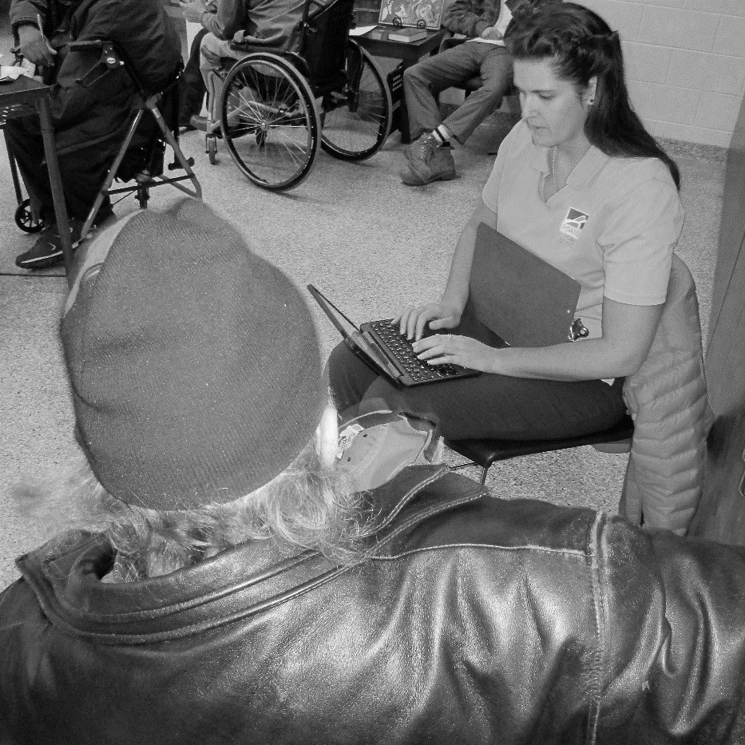
2018 Point-in-Time Survey Findings (cont.)
Disabilities
18.8% (27 of 144 individuals) reported having a permanent physical disability
Coming here in a homeless condition
43.2% (48 of 111) individuals surveyed reported living outside of the Continuum of Care’s service area prior to becoming homeless
53% (23 of 48) individuals reporting living outside the CoC’s service area prior to becoming homeless came from other states; 25 of the 48 (48%) came from other parts of Virginia

Slide 15
Conclusion
This is the first year since 2012 that homelessness has increased in the Roanoke Region since 2012. Likely contributors to the 18.7% increase are funding cuts to vital links in our community’s coordinated response to individuals in a housing crisis. Funding for homelessness prevention services from private sources decreased by more than 50% in the last fiscal year. Emergency financial assistance for rent and utility payments through the City of Roanoke’s Department of Social Services was eliminated this year.
Two significant achievements: the unsheltered count (our most vulnerable and most costly to serve clients) decreased by 18%. The Rescue Mission’s full participation in HMIS is significant as 68% of the emergency shelter beds in our community and 78% of the individuals counted in the PIT were staying at the Mission. Having this data in our HMIS is game-changing. This will open doors for community-level planning, service coordination and resource targeting that did not exist in the past.

Slide 16
QUESTIONS
Paula L. Prince Matt Crookshank
Assistant Professor Director of Homeless Services
Jefferson College of Health Sciences Council of Community Services
Humanities and Social Sciences mattc@chrcblueridge.org
plprince@jchs.edu (540) 266-7554
(540) 985-8380
Carol Tuning
Human Services Administrator
Chair, Blue Ridge Continuum of Care
(540) 312-8301
Carol.tuning@roanokeva.gov

